Slide 1
Cell Division in Humans- Mitosis

Slide 2
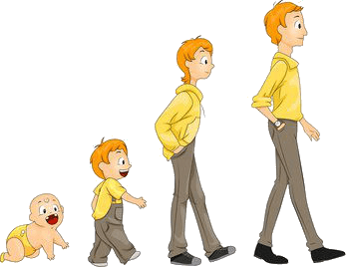
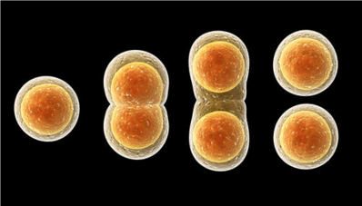
In this Smart Lesson on human cell division, you will be doing the following:
1. | Describing the process of mitosis.
2. | Explaining how mitosis is used for growth, repair and development of the body.
3. | Evaluating the importance of mitosis.

Slide 3
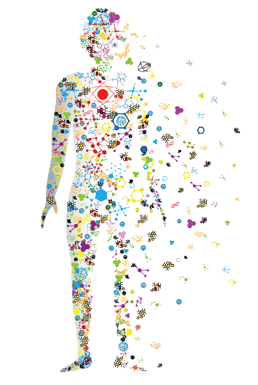
Multicellular organisms, like yourself, grow because cells in your body divide to make new cells.
Cell division is when one cell divides into two cells. Every person started out as a single cell, and by the time you become an adult you will be made up of approximately 37.2 trillion cells!

Slide 4
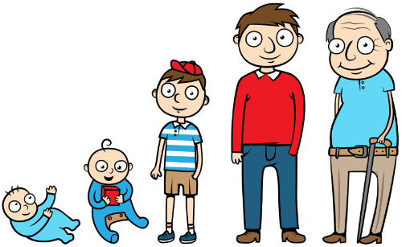
Cell division is important for growth and development.
Even now that you have developed all the body parts that you need to live, you are still growing taller!
In order to grow taller, your bones need to get longer by bone cells dividing to make more bone cells. Your muscles need to get bigger to hold up your bigger body, which is through muscle cells dividing. And your skin needs to get bigger to cover your growing body! Guess what: this is through skin cells dividing.

Slide 5
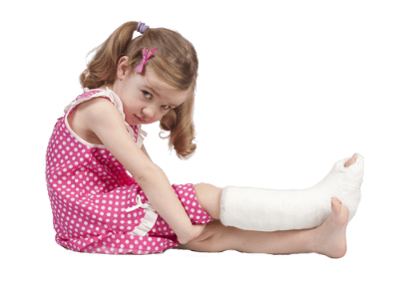
Cell division is also important for repairing damage to your body.
If you get a wound, the cells are damaged and need to be replaced by new cells of the same type. For example, if you break your leg, the bone cells near the break will divide to make new bone cells and heal the bone.

Slide 6
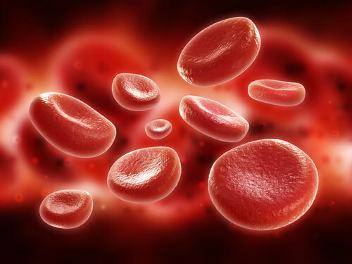
Some types of cells also need to be frequently replaced by new cells.
For example, every 4 months all the red blood cells in your body are replaced with new red blood cells! Your skin cells grow even faster - the outer layer of your skin is completely replaced every 2−4 weeks.

Slide 7
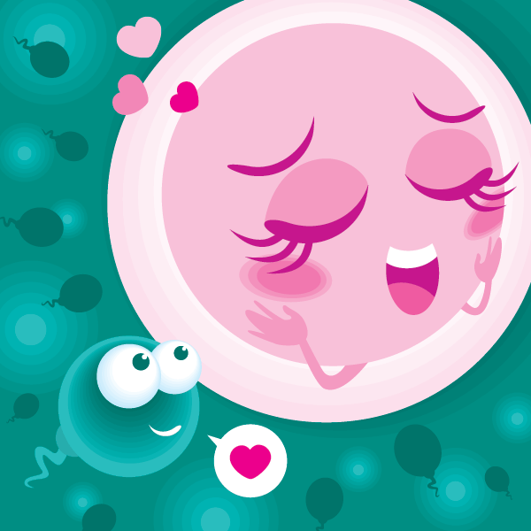
Cell division is required for reproduction.
Reproductive cells (sex cells) divide to produce sperm cells (in males) or egg cells (in females).
One sperm cell from the father and one egg cell from the mother then join together and produce a new organism that is different from both parents. This is a different type of cell division to the type used for growth and repair.

Slide 8

The type of cell division used for growth and repair in your body cells is called mitosis.
Mitosis is constantly occurring in different cells in your body, helping you to grow taller and stronger, healing your wounds, and growing your hair and fingernails.

Slide 9
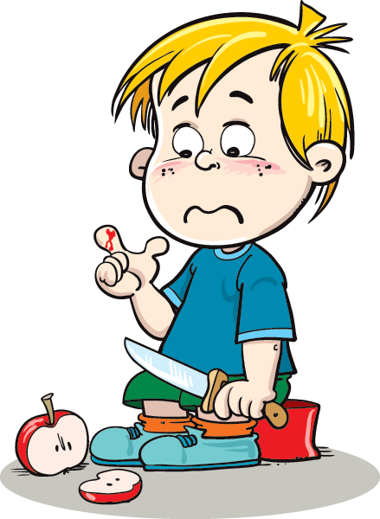
During mitosis, one cell divides into two cells.
The cells produced during the process of mitosis are identical to the original cell.
This is important because mitosis is used mainly for growth and repair. If you cut your skin, you need identical skin cells to be produced to heal the cut.

Slide 10

Each new cell must have a full copy of the original cell's DNA in order for it to function properly.
This is because the DNA is the information code that determines how a cell functions. This means the DNA must be copied (replicated) before the cell divides. This way, each new cell can receive a full copy of DNA.

Slide 11
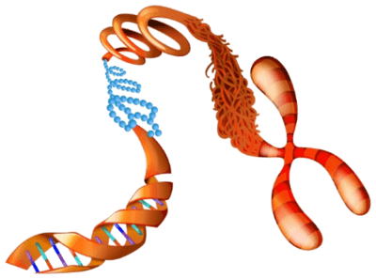
Once the DNA is copied, it is time to start preparing for division.
The first step of division is to condensing the DNA into chromosomes. This keeps the DNA organised during cell division.
This is really important, since there is a lot of DNA in each cell. If the DNA in just one of your body cells was stretched out, it would be over 2m long!

Slide 12
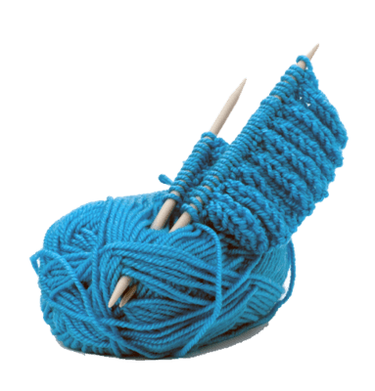
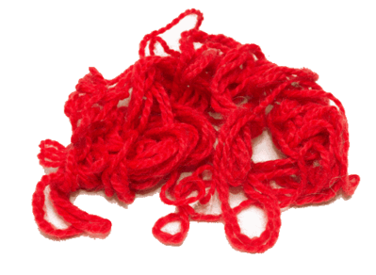
But why do chromosomes help keep the DNA safe?
Think of DNA like wool. If you wanted to do some knitting, but your wool was not wound into a ball, it would be very difficult to do without the wool getting tangled or broken.
But if the wool was wound up into a ball, you could easily unwind it to use for knitting. Chromosomes are like a ball of wool. They are made from DNA wound up into a linear structure, which stops the DNA from becoming tangled or broken during cell division.

Slide 13
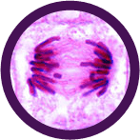
The next step of cell division is to dissolve the nucleus.
Remember, the nucleus is where DNA is normally stored. Dissolving the nucleus allows the cell to drag each copy of the DNA to opposite sides of the cell.

Slide 14
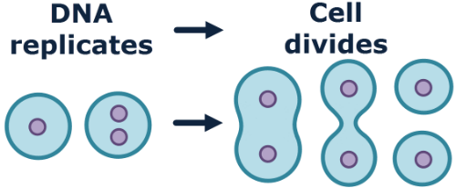
Finally, the cytoplasm and cell membrane pinch together in the middle.
The cell splits into two, creating two new identical cells, each with one copy of the DNA. Cell division is complete!

Slide 15
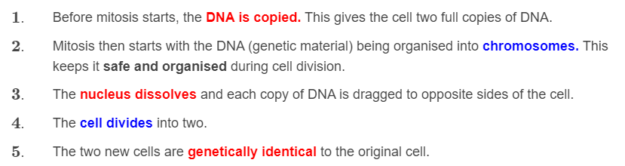
Mitosis sounds like a very complicated process, so here is a summary of the main points:

